Slide 1
Sidewalk Accessibility
Client
Ramandeep Josen
Team 2 Members
Billy Nowosielski, Xiao Zhang(Team Lead), Arnav Mishra, Haocheng Zhao

Slide 2
Goal
Create Accessibility Scores for sidewalks that can be used to determine areas in need of improvement. Also find best routes for people to walk to the public facilities
Background
The current system requires residents to call to report sidewalk issues/hazards. We are trying to see through the data how the current system is helping the various regions of boston and where the help may be lacking. Therefore, with the introduction of accessibility scores we will be able to determine the areas that are not receiving proper treatment of their sidewalks.

Slide 3
Data Analysis
So far we have done preliminary analyses on the data and are currently working on doing a more in depth analysis using the newly provided ramp scores, and sidewalk locations. We have plotted the data to a real map and we can have direct visions of them to find our research directions.
Data
So far we have analyzed all of the initial datasets. As for the new ones we have decided to focus more on the ramps data set with its new accessibility score and the sidewalks dataset to determine accessibility scores for entire sidewalks. We aim to make use of all the elements to decide whether a sidewalk is in good conditions.
DataSets: Ramps_new.json, Sidewalks.json, Hospitals.csv, Schools.csv and so on

Slide 4
Early Observations
Using the sidewalk hazards dataset and pinpointing the locations of the fixed hazards we overlaid it with a map of the neighborhoods in boston which shows how many repairs each neighborhood is getting. Generally the hazards are gathering together.
Early Challenges With The Data
Early on we had several problems the main being a lack of documentation to aid in the interpretation of the datasets. Another challenge came from issues with displaying the data from sidewalks in a meaningful way since they were large areas and not singular points with a latitude and longitude.

Slide 5
Early results and Visions

Slide 6
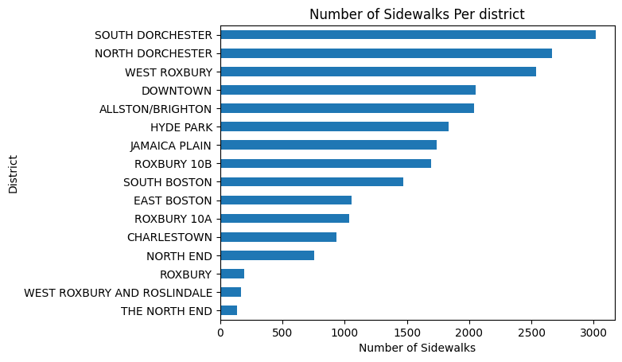
A preview of Sidewalks
Having this plot, we can divide them into different groups for the sidewalk numbers that they have.
Start with small groups will be a good choice to adjust the model. Then we can try to fit into the larger ones.

Slide 7
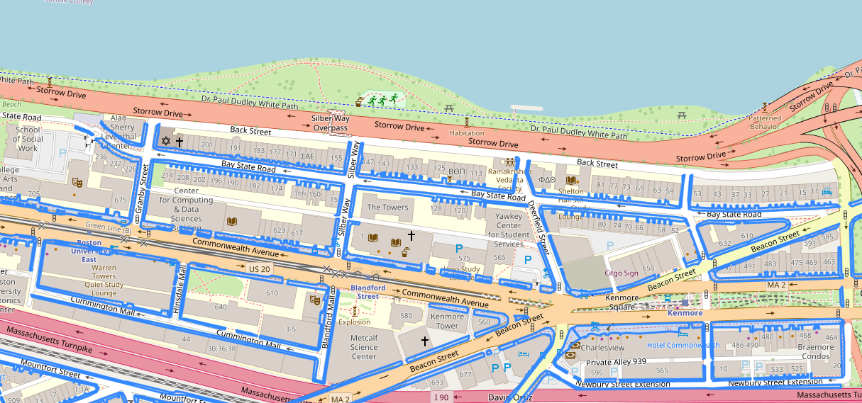
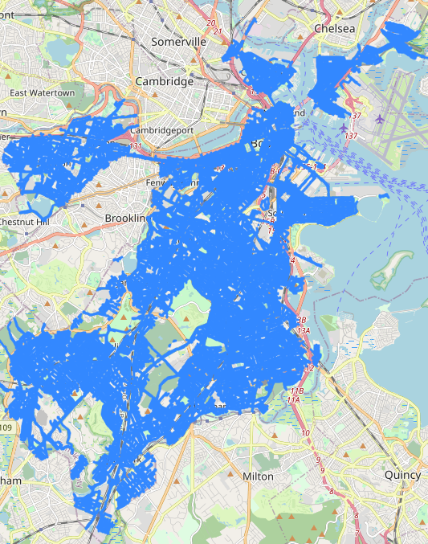
Sidewalk Shape

Slide 8
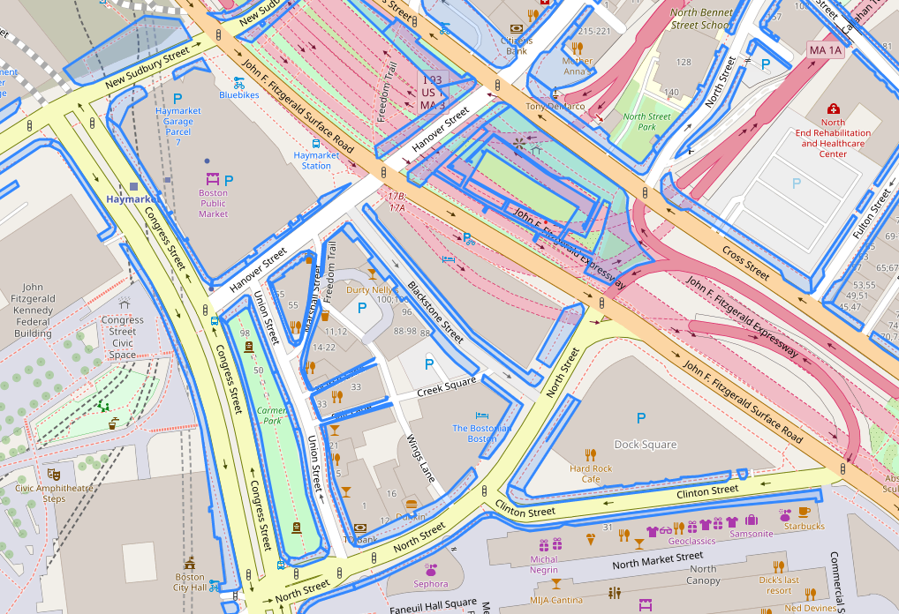
Sidewalk shape
We draw these blue sidewalk shapes using data we gathered and we will make markers on this base map to give more interpretations of data and research directions.

Slide 9
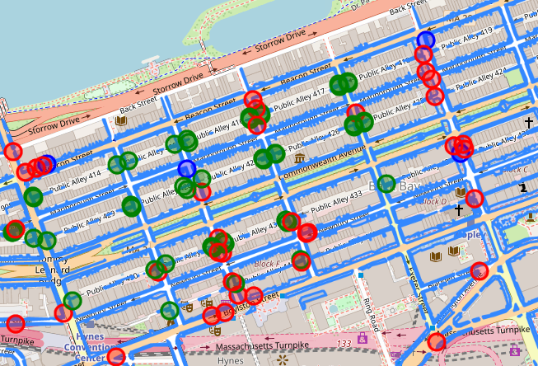
Hazards on sidewalks
Then we added the places where hazards happened so that we can have a concept of hazards on these sidewalks
Red- Trip hazards not due to tree roots
Blue- Trip hazards due to tree roots
Green - Fixed pinch point <36” sidewalk width

Slide 10
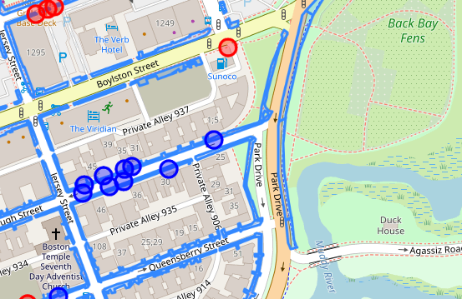
Hazards on sidewalks
For example, this street is full of blue points. There are so many hazards due to tree roots.
We can guess the species of trees are special here. Or the nearby park is influencing this street by strong winds.

Slide 11
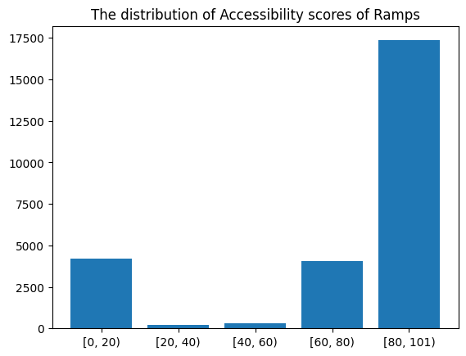
An preview of Ramps
There are about 17500 ramps are rated as a fairly good or excellent conditions and 4000 ramps are rated as harsh conditions.
We will try to focus on these two score area to modify our model.

Slide 12
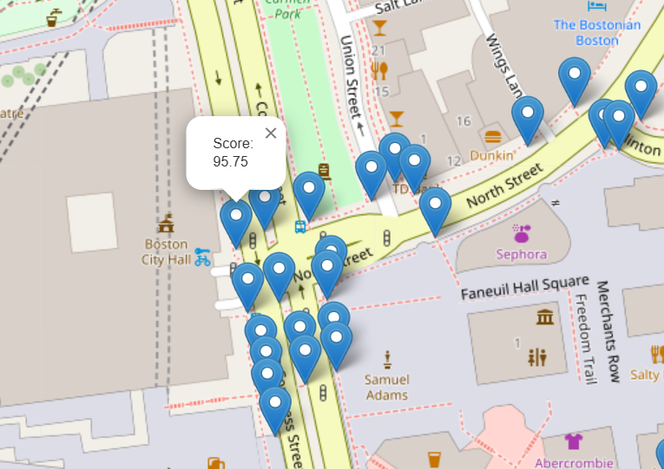
Ramps with their scores
We make a marker on the map to show the score of each ramp point.
It can clearly help us to pinpoint the issues that we are going to work on.

Slide 13
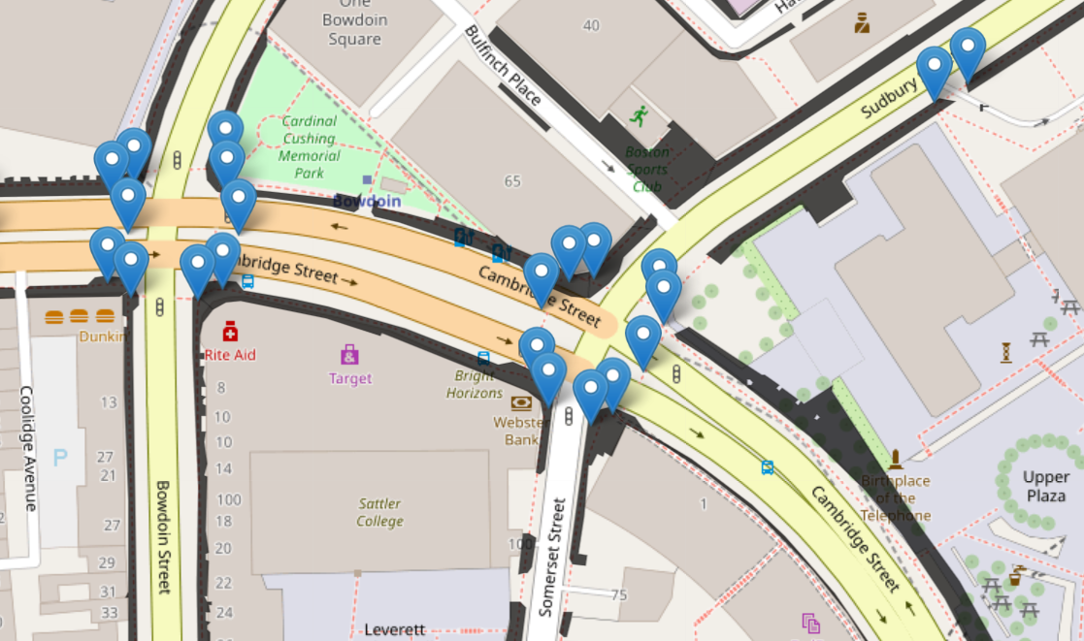
Ramps connecting to Sidewalks
We overlaid the ramp points onto the sidewalks. The sidewalks’ colors are black at present, because we aim to change their colors according to their average scores once we finish the whole connection to the ramps_scores.
We met with some challenges.

Slide 14
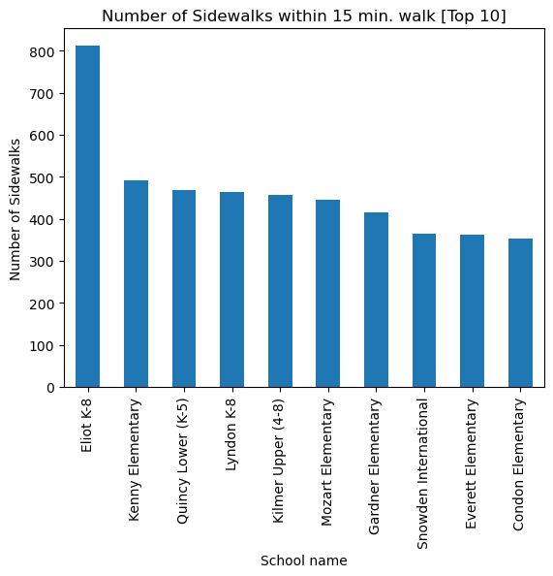
About Schools(children)
We truly care about children who are the most common user of sidewalks.
Right? They walk on them after schools, they play with their friends on them, they walk their dogs on them and the way to school is the most important one.
The freedom of childhood should be protected by adults, first from the sidewalks safety.

Slide 15
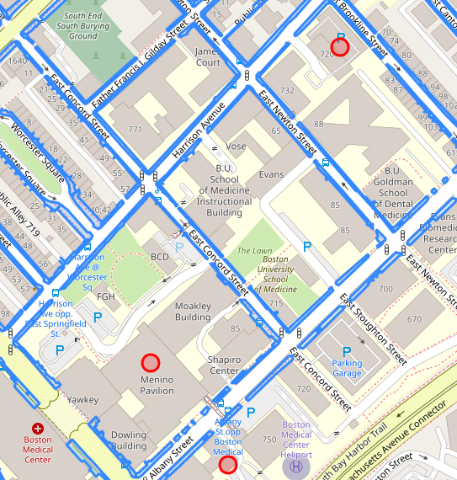
About the hospital(Patients)
We make use of the hospital information on Boston Analysis.
After we color the nearby sidewalks with their accessibility scores successfully, we can figure out the total sidewalk accessibility of this hospital

Slide 16
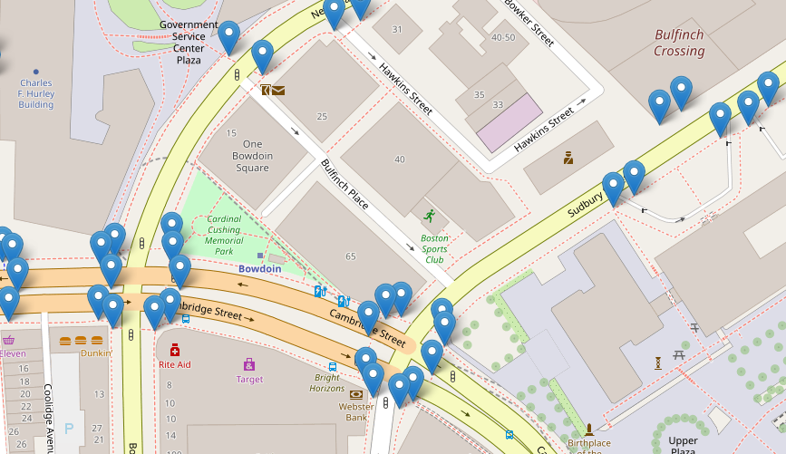
Challenges
First of all, the ramp points are too many of them. We need to somehow reduce the calculation workload of plotting them all or fitting them into our model.
Something first come to my mind is using KNN method to cluster nearby ramp points to one “virtual ramp”

Slide 17
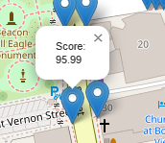
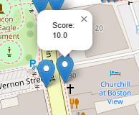
Challenges
These ramp points sharing almost the same position, have completely different accessibility score.
We need to make sure such cases will not be ignored by our models or be neglected because of wrong records.

Slide 18
Limitations
Recently the limitations are still our own technological limitations, we still need some time to handle and make full use of present datasets and resources. There are also noise points or wrong data or vacant data in the datasets. We need make sure that they are not going to influence our final results.
Expected Next Steps
Once we complete the scores for each sidewalk(including the ramps and hazards), we will connect other facilities or places like neighborhoods or parks. We have connected the hospitals and schools. It should be good to connect them as well.
And then, giving comprehensive scores to neighborhoods and clustering them into different priorities for governments should be our main focus.
Meanwhile, we will try to apply a smart path navigation for people from different neighborhoods to different facilities.

Slide 19
Thanks!
Presenter: Xiao Zhang
Team 2

